Slide 1
Load.in
Using AI and Computer Vision to give your move a game plan.
Team Yellow
Feasibility Presentation
Old Dominion University
10/12/2020
Notes:
This slide is a non-animated version of the following slide. (Title Slide)
1

Slide 2
Load.in
Using AI and Computer Vision to give your move a game plan.
Team Yellow
Feasibility Presentation
Old Dominion University
Notes:
This slide is an animated version of the previous slide. (Title slide)
2

Slide 3
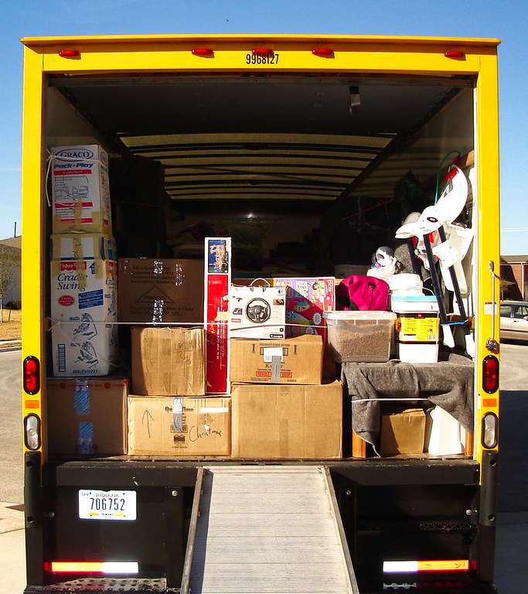
Load.in
Using AI and Computer Vision
to give your move a game plan.
Team Yellow
Feasibility Presentation
Old Dominion University
10/12/2020
Notes:
This slide is a non-animated version of the following slide. (Title Slide)

Slide 4
Contents
Team Biography: 4
The Problem: 5
Problem Statement: 9
Problem Characteristics: 11-16
Current Process Flow: 17-19
Major Functional Component Diagram: 20-21
Risk and Mitigation: 25-26
Competition: 27
References: 29
Glossary: 30
10/12/2020
CS 410 – Team Yellow – Load.In – Feasibility
4
Notes:
4

Slide 5







Who is Team Yellow?
Byron Aquilino
Lance Perdue
Greg Kukanich
Jason Moran
Daniel Reyna
Chris Miller
Paul Rodriguez
10/12/2020
CS 410 – Team Yellow – Load.In – Feasibility
5
Notes:
5

Slide 6

“Do It Yourself” movers lack the expert knowledge required to handle the logistics of their move.
This Photo by Unknown Author is licensed under CC BY
10/12/2020
CS 410 – Team Yellow – Load.In – Feasibility
6
Notes:
TODO: change the graphic to something more subtle (Completed by Lance)
Photo source: https://www.theritemove.com/2019/09/30/game-plan-making-sure-you-pack-up-everything-of-importance/
6

Slide 7
Do it Yourself Moving
Professional movers reduces the time but increases cost
DIY reduces the cost but increases time
DIY movers lack expert knowledge
This is where Load.in Comes in
This Photo by Unknown Author is licensed under CC BY
10/12/2020
CS 410 – Team Yellow – Load.In – Feasibility
7
Notes:
TODO: ask janet tomorrow
Photo source: https://www.theritemove.com/2019/09/30/game-plan-making-sure-you-pack-up-everything-of-importance/
7

Slide 8
Professional Movers Are Costly
10/12/2020
CS 410 – Team Yellow – Load.In – Feasibility
8
Notes:
https://www.hireahelper.com/movers-academy/on-the-job/estimating-job-times/
https://www.uhaul.com/Reservations/RatesTrucks/
https://www.move.org/average-cost-truck-rental/
https://www.victoryvan.com/moving-and-storage/how-long-takes-move-new-house
https://www.movers.com/moving-guides/moving-four-bedroom-house-costs.html
TODO: adjust the header sizes for the graphs
8

Slide 9
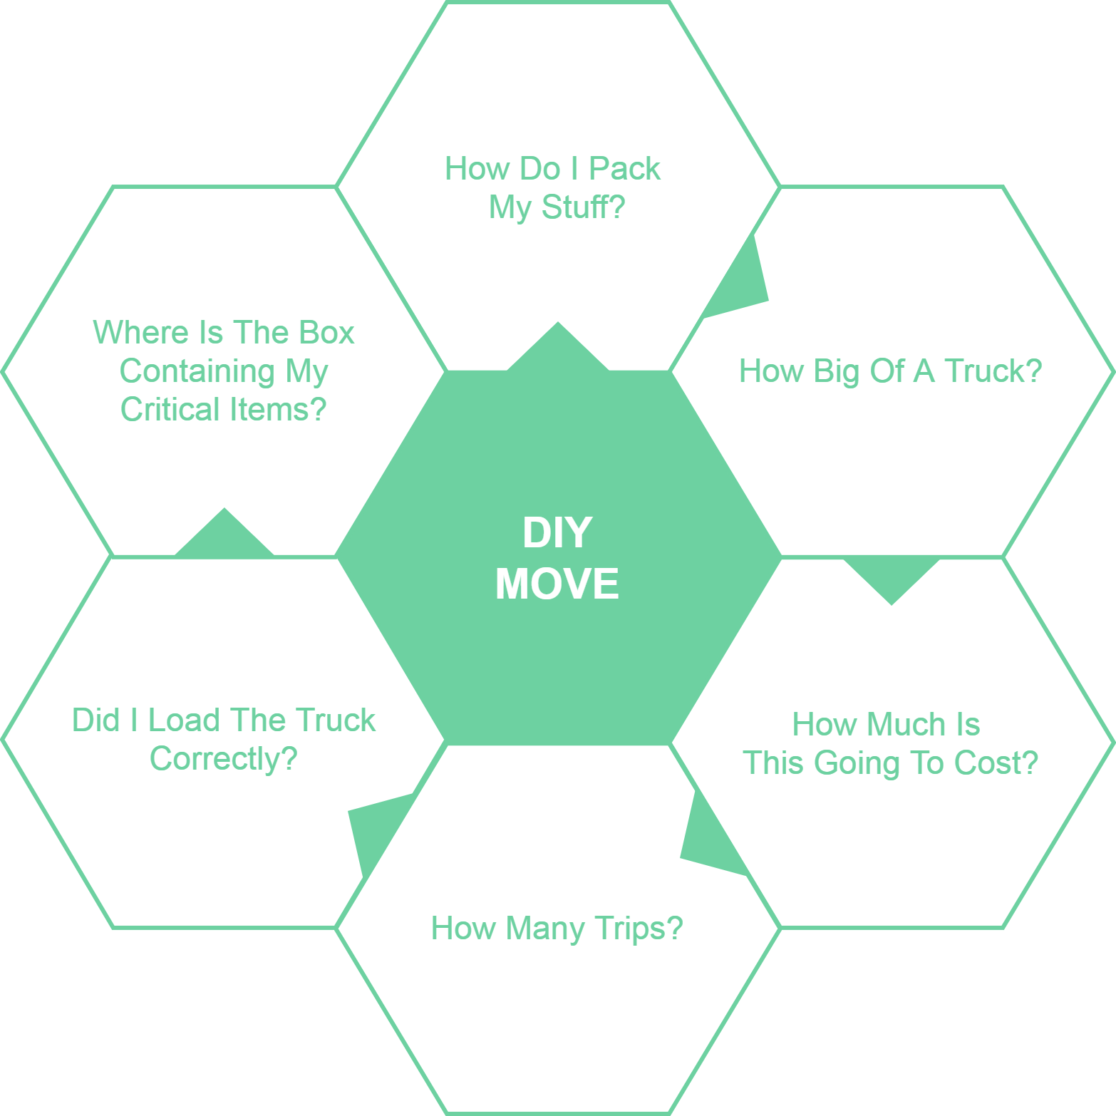
10/12/2020
CS 410 – Team Yellow – Load.In – Feasibility
9
Notes:
9

Slide 10
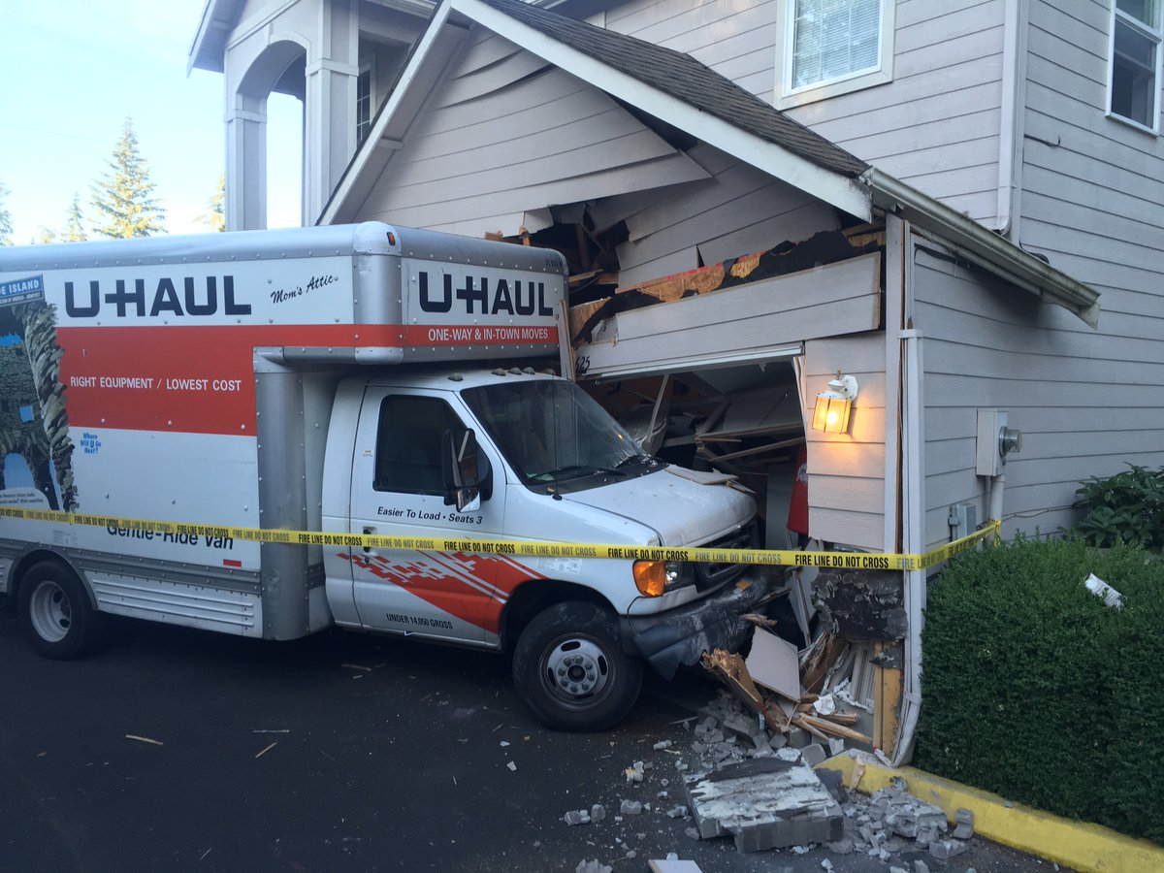
Loading can be a major issue
Poor loading can cause
Property damage
Car accidents
An estimated 50,000 accidents related to trailer towing occur each year.
This Photo by Unknown Author is licensed under CC BY
Hayesbc.com
10/12/2020
CS 410 – Team Yellow – Load.In – Feasibility
10
Notes:
10

Slide 11
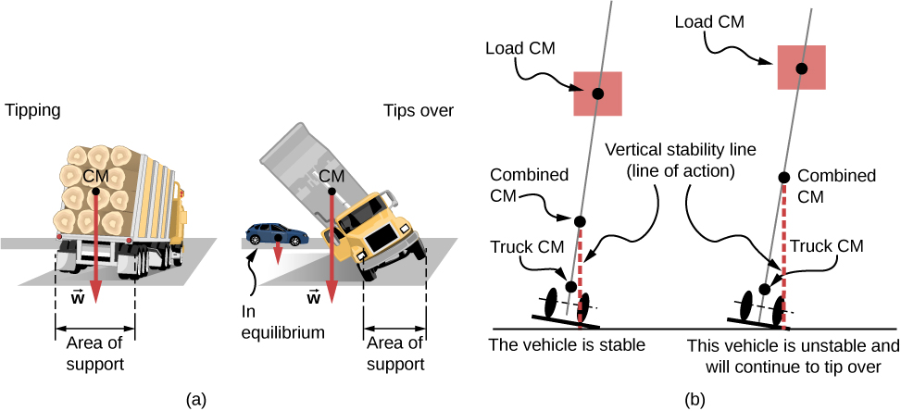

Major Truck Loading Considerations
Weight distribution
Protecting fragile items
This Photo by Unknown Author is licensed under CC BY
PenskeTruckRental.com
10/12/2020
CS 410 – Team Yellow – Load.In – Feasibility
11
Notes:
11

Slide 12
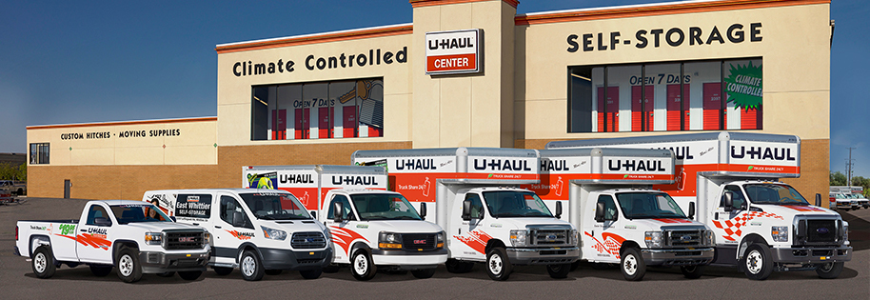
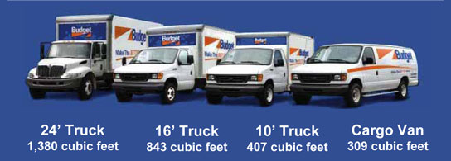
Figuring out what to rent is hard!
Accurately determining
How big of a truck to get
How many trips a move will take …is difficult.
Rental Truck companies base their business model on this!
wtkr.com
10/12/2020
CS 410 – Team Yellow – Load.In – Feasibility
12
Notes:
12

Slide 13

Figuring out what to rent is hard!
Accurately determining
How big of a truck to get
How many trips a move will take …is difficult.
Rental Truck companies base their business model on this!
Autoclinicpepperell.com
wtkr.com
10/12/2020
CS 410 – Team Yellow – Load.In – Feasibility
13
Notes:
Ask her if she likes this better and then remove one or the other
13

Slide 14
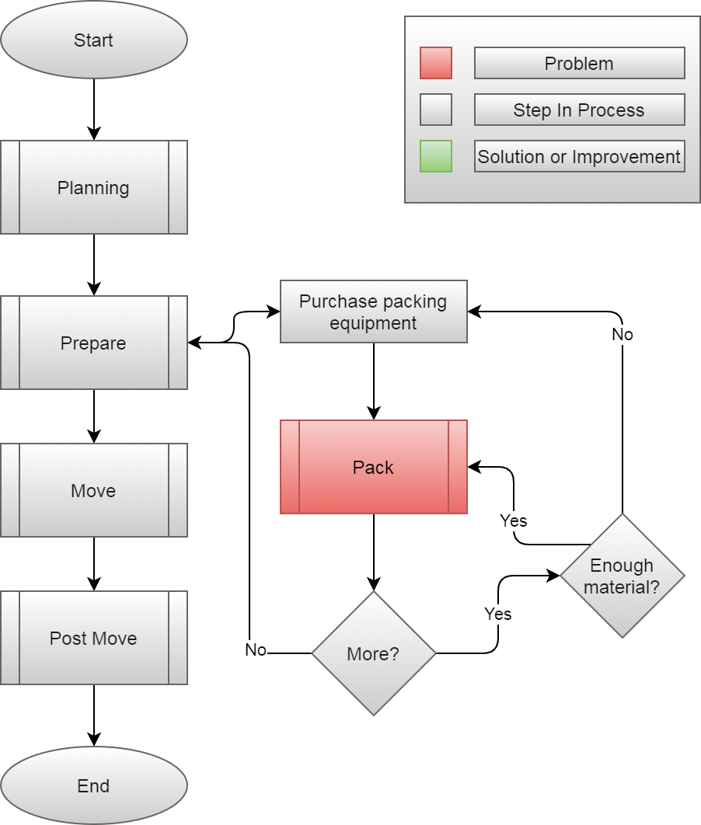
Current Process
10/12/2020
CS 410 – Team Yellow – Load.In – Feasibility
14
Notes:
14

Slide 15
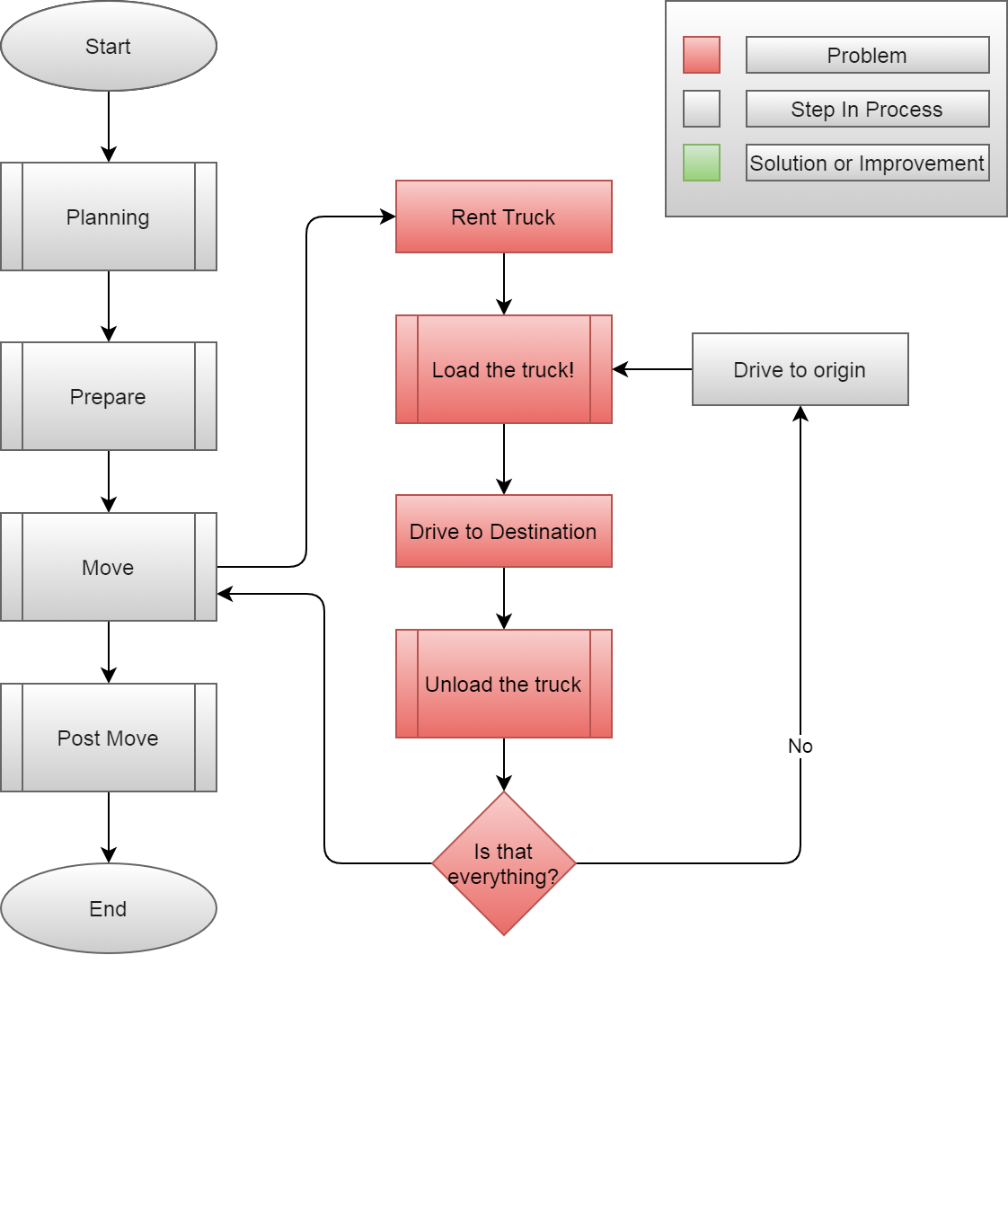
10/12/2020
CS 410 – Team Yellow – Load.In – Feasibility
15
Notes:
15

Slide 16

Load.In gives your move a game plan
Uses artificial intelligence and computer vision
Provides
Expert-level instructions
Tips and tricks on moving day
This Photo by Unknown Author is licensed under CC BY
10/12/2020
CS 410 – Team Yellow – Load.In – Feasibility
16
Notes:
Make a note of pointing out how these people are much happier as a result of using Load.In
Source for image https://www.realtor.com/advice/move/unpack-like-a-pro/
16

Slide 17
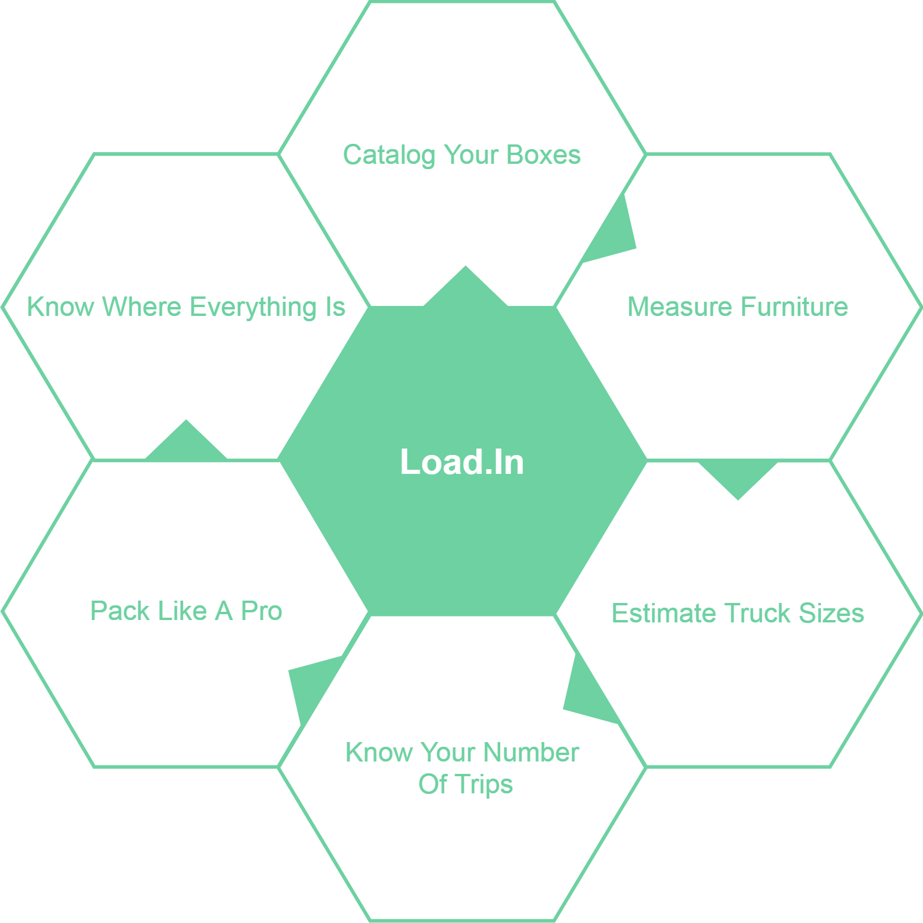
What Can Load.In Do
For You?
10/12/2020
CS 410 – Team Yellow – Load.In – Feasibility
17
Notes:
17

Slide 18
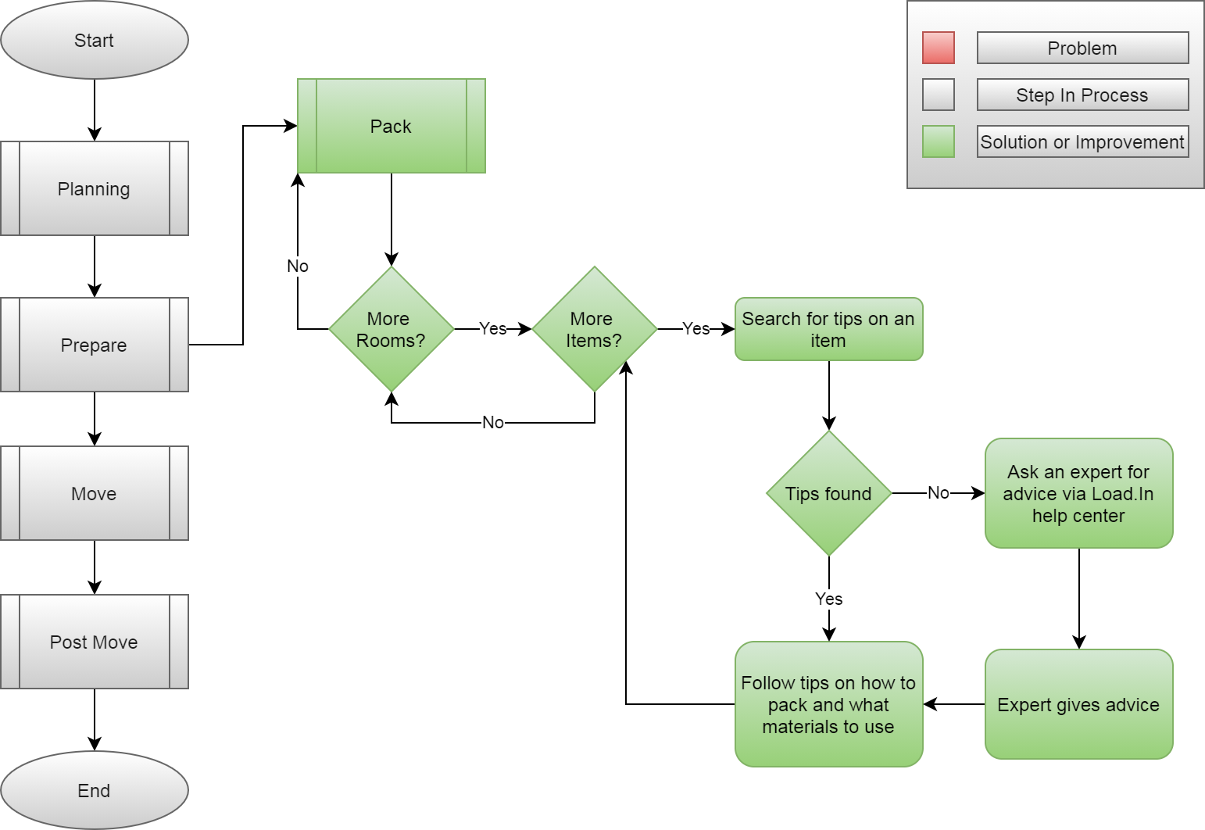
How will the solution help?
10/12/2020
CS 410 – Team Yellow – Load.In – Feasibility
18
Notes:
18

Slide 19
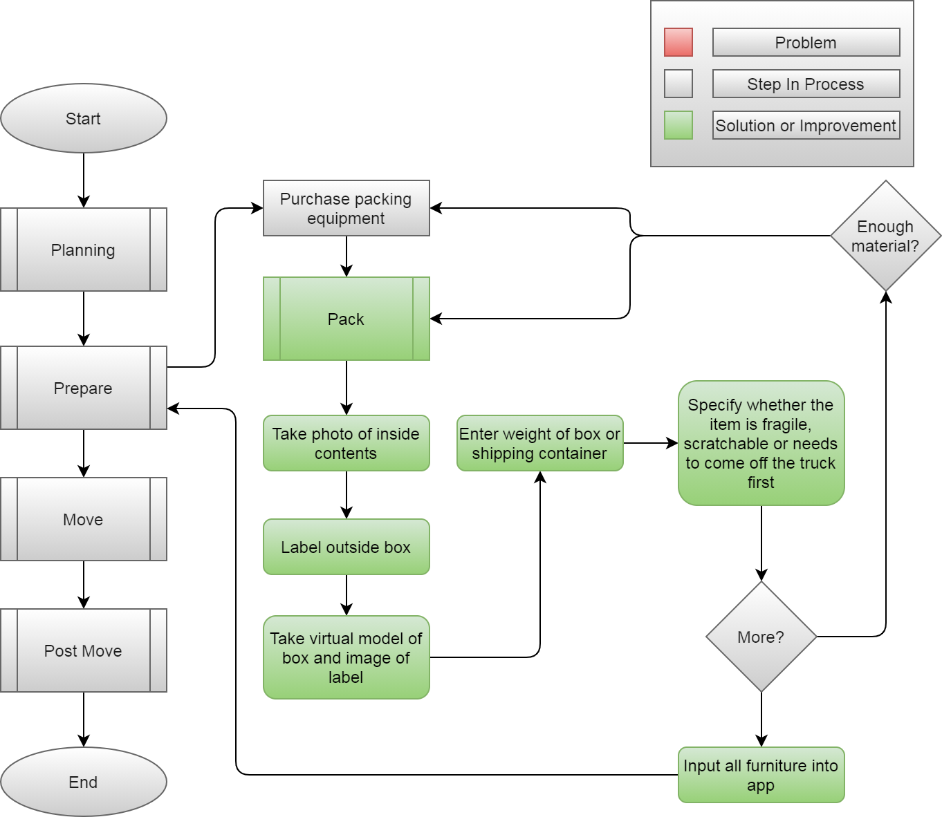
10/12/2020
CS 410 – Team Yellow – Load.In – Feasibility
19
Notes:
19

Slide 20
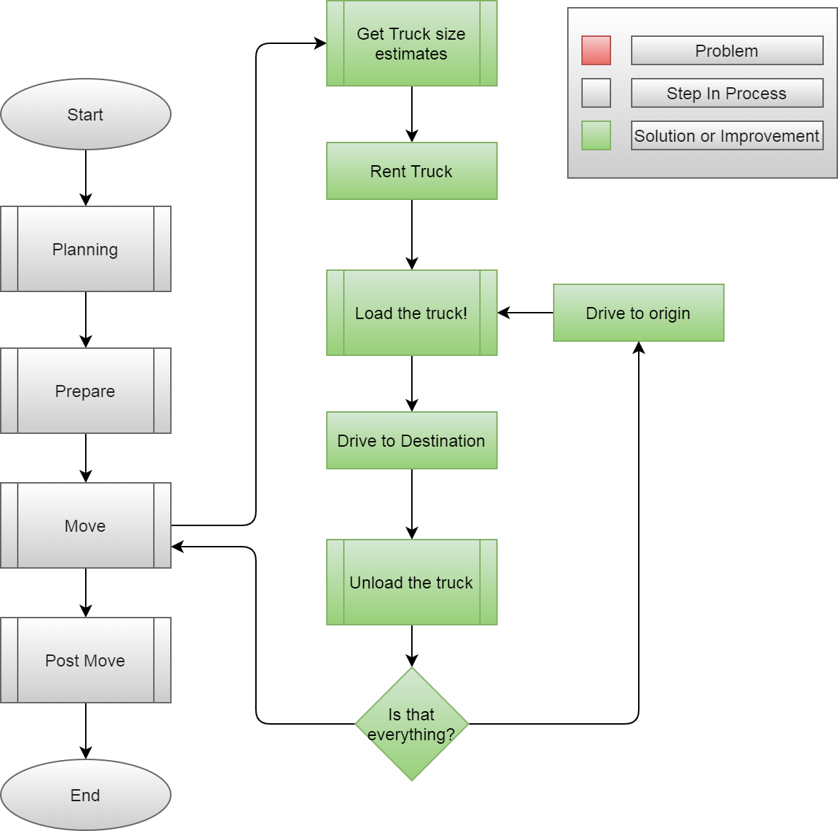
10/12/2020
CS 410 – Team Yellow – Load.In – Feasibility
20

Slide 21
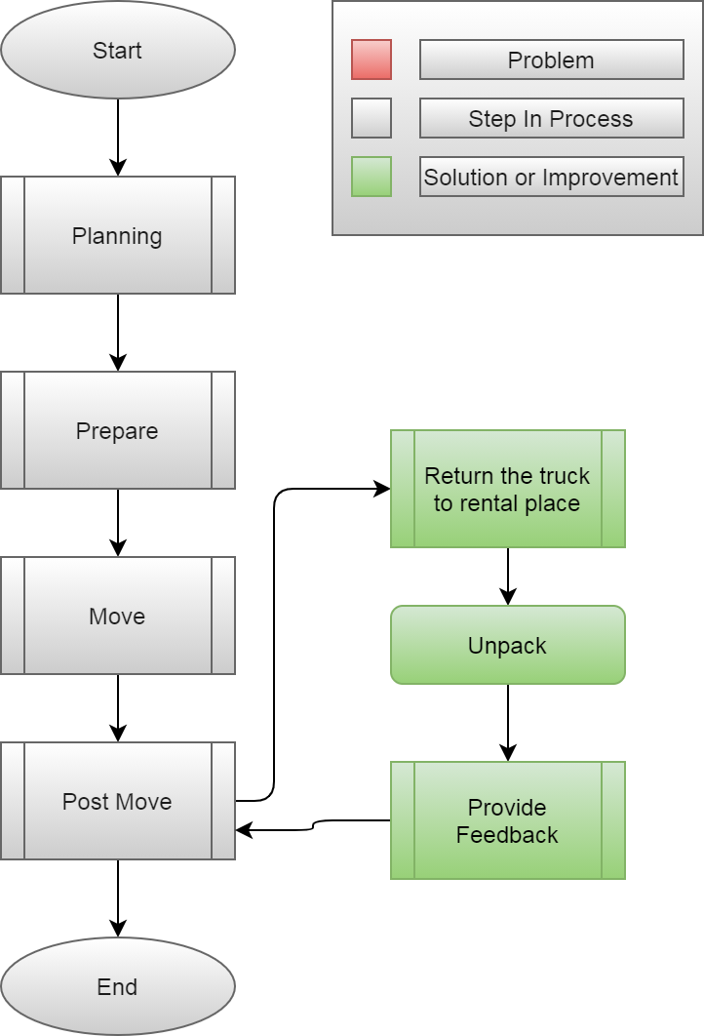
10/12/2020
CS 410 – Team Yellow – Load.In – Feasibility
21

Slide 22











Feedback Loop
Input
4
3
Training data
6
5
2
1
Pro loading strategy
Neural Network
App generates 3D models of objects to move
Output
Incorporate Feedback in to training data generation
Experience
Instructions
User gives feedback
User follows plan
Loading Plan
10/12/2020
CS 410 – Team Yellow – Load.In – Feasibility
22
Notes:
22

Slide 23
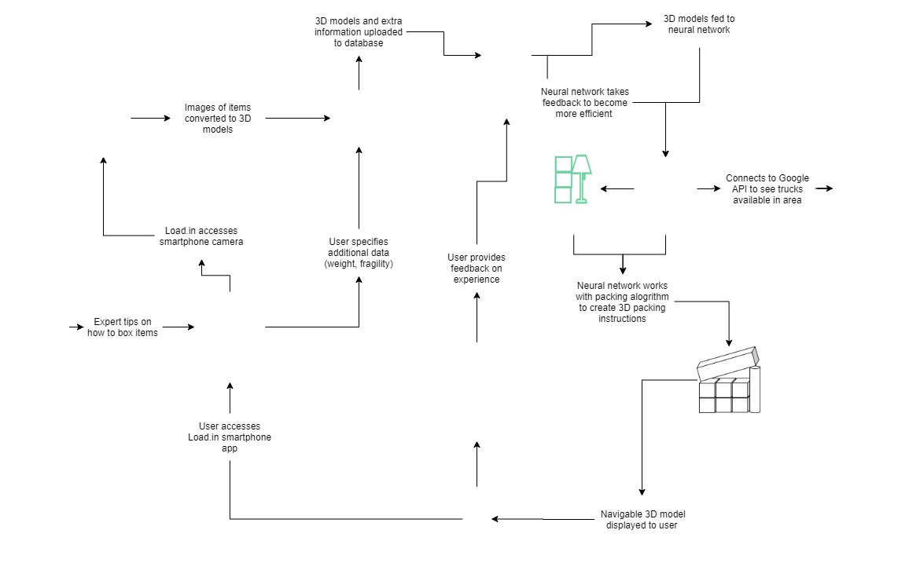
Major Functional Components
10/12/2020
CS 410 – Team Yellow – Load.In – Feasibility
23
Notes:
23

Slide 24
What Load.In Will Do
Assist in the packing process with expert advice
Catalog with photos all boxes, furniture, and other items that are going to be placed in the truck
Generate instructions for properly loading the truck based on weight distribution, item safety, best fit space utilization, and item(s) priority
Use photos taken to Create a 3D model of how everything should be expertly packed in the truck
Will provide location information for different boxes and items within the truck using 3D model and cataloging
Give estimate for appropriate rental truck size and number of trips dependent on truck size
10/12/2020
CS 410 – Team Yellow – Load.In – Feasibility
24

Slide 25
What Load.In Won’t Do
Pack boxes
Load or unload truck
Assist in the driving process
10/12/2020
CS 410 – Team Yellow – Load.In – Feasibility
25

Slide 26

The Moving Industry Market
Nearly all moving companies are either all inclusive or DIY
However the all inclusive services are often very expensive
All of the DIY services provide no assistance or guidance and lead to confusion and wasted money
The market is shifting towards software being utilized to increase efficiency and decrease costs
This Photo by Unknown Author is licensed under CC BY
10/12/2020
CS 410 – Team Yellow – Load.In – Feasibility
26

Slide 27
Benefits to the Customer
Being shown how to
Pack boxes for increased organization.
Properly load their truck for increased efficiency.
Being provided with a database of useful tips from professional movers.
Saving of money and time due to the entire moving process being made more efficient.
10/12/2020
CS 410 – Team Yellow – Load.In – Feasibility
27

Slide 28
Technical Risks
Probability
 |  | Very Low | Low | Medium | High | Very High
Severity | Very High |  |  |  |  | T-1
 | High |  |  |  | T-2
 | Medium |  |  | T-3
 | Low
 | Very Low
T-1: Current technology involving machine vision is a challenge.
T-1 Mitigation: Conduct a prototype to mitigate risk of critical errors upon release.
T-2: Artificial Intelligence prone to error due to insufficient training data.
T-2 Mitigation: Implementing a feedback loopback in the beta phase with test users.
T-3: Challenge to obtain accurate and timely feedback.
T-3 Mitigation: Implement a feature for users to give feedback if the application operated correctly after completing a move.
10/12/2020
CS 410 – Team Yellow – Load.In – Feasibility
28
Notes:
28

Slide 29
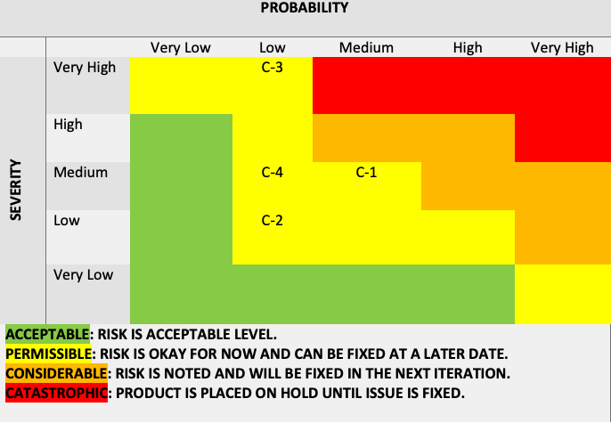
Customer Risks
C-1: End user is inexperienced with the application.
C-1 Mitigation: Implement a tutorial on how to use the application and provide a help feature.
C-2: End user finds UI challenging to operate.
C-2: Mitigation: Implement analytics for tracking when a user stop using the application.
C-3: End users are not satisfied with the recommendations of the application.
C-3 Mitigation: Implement a customer feedback feature that allows the users to disclose his/her issues with the applications.
C-4: End user doesn’t follow the guidelines of the application.
C-4 Mitigation: Implement a feature that allows the user to repeat/reset certain steps in the application as they progress.
Probability
 |  | Very Low | Low | Medium | High | Very High
Severity | Very High
 | High |  | C-3
 | Medium |  | C-1 | C-2
 | Low |  |  |  | C-4
 | Very Low
10/12/2020
CS 410 – Team Yellow – Load.In – Feasibility
29

Slide 30
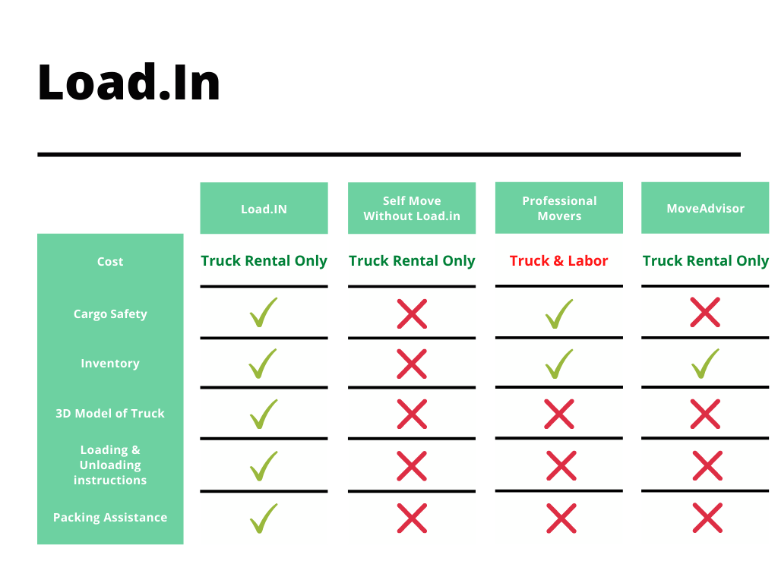
The Competition
10/12/2020
CS 410 – Team Yellow – Load.In – Feasibility
30
Notes:
30

Slide 31
Conclusion
DIY Movers are faced with many logistical difficulties
Properly loading truck
Protecting valuables
Finding the best deal
Keeping track of every box
All during an already stressful life event!
Load.In will provide customized expert instructions
Truck loading instructions based on photogrammetry
Cost minimization based on input data
Map of truck available to assist in finding boxes

Slide 32
Notes:
End of presentation.

Slide 33
Sources:
The Top 5 Moving Mistakes Across America. (2019, August 13). Article. https://www.article.com/blog/top-5-moving-mistakes/
Economy Moving & Storage, LLC. (2015, January 4). How to properly pack and load a moving truck- Movers Cincinnati. YouTube. https://www.youtube.com/watch?v=rjmofUZOdwo&feature=youtu.be
CADCode Systems. (n.d.). Optimizing & Machining | CADCode Systems. CADCode.Com. Retrieved September 20, 2020, from https://www.cadcode.com/category/categories/optimizing-machining
Dube, E. (2020, September 20). OPTIMIZING THREE-DIMENSIONAL BIN PACKING THROUGH SIMULATION. Semantics Scholar. https://www.semanticscholar.org/paper/OPTIMIZING-THREE-DIMENSIONAL-BIN-PACKING-THROUGH-Dube/bb9986af2f26f7726fcef1bc684eac8239c9b853#references
Knoblauch, M. (2019, May 8). One in ten Americans would prefer a week in jail over moving. New York Post. https://nypost.com/2019/05/08/one-in-ten-americans-would-prefer-a-week-in-jail-over-moving/
The American Institute of Stress. (n.d.). The Holmes-Rahe Stress Inventory PDF. Retrieved September 20, 2020, from https://www.stress.org/wp-content/uploads/2019/04/stress-inventory-1.pdf
Wood, T. (2020, January 6). Moving Industry Statistics. MoveBuddha. https://www.movebuddha.com/blog/moving-industry-statistics/
Nat and Friends. (2017, April 18). Google Earth’s Incredible 3D Imagery, Explained. YouTube. https://www.youtube.com/watch?v=suo_aUTUpps&feature=youtu.be
Collins, T. (2018, April 20). A Look Into Photogrammetry and Video Games - Tiger Collins. Medium. https://medium.com/@homicidalnacho/a-look-into-photogrammetry-and-video-games-71d602f51c31
10/12/2020
CS 410 – Team Yellow – Load.In – Feasibility
33
Notes:
33

Slide 34
Glossary:
*All definitions are sourced from Wikipedia
Photogrammetry
Photogrammetry is the science and technology of obtaining reliable information about physical objects and the environment through the process of recording, measuring and interpreting photographic images and patterns of electromagnetic radiant imagery and other phenomena.
Algorithm
A finite sequence of well-defined, computer-implementable instructions, typically to solve a class of problems or to perform a computation.
Professional movers
Professionals who move all your belongings for you from one place to another.
Packing problems
Are a class of optimization problems in mathematics that involve attempting to pack objects together into containers. The goal is to either pack a single container as densely as possible or pack all objects using as few containers as possible.
10/12/2020
CS 410 – Team Yellow – Load.In – Feasibility
34
Notes:
34

